Slide 1

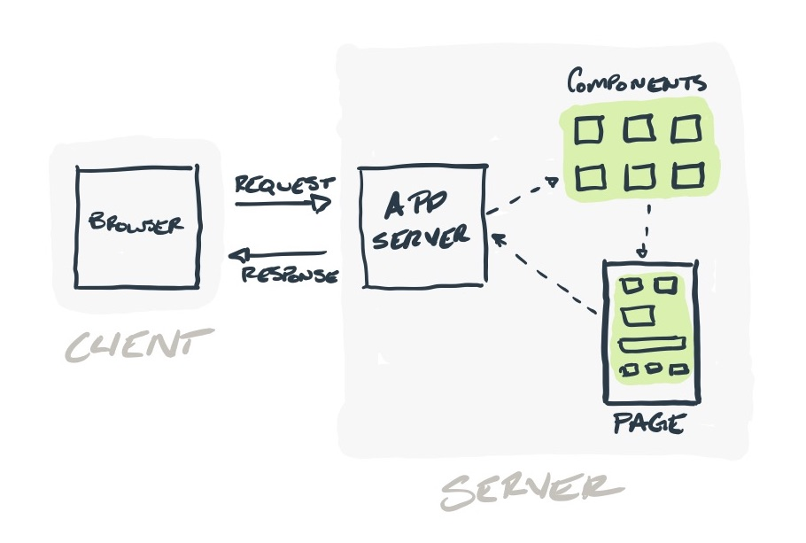
SATHYABAMA INSTITUTE OF SCIENCE AND TECHNOLOGY
DEPARTMENT OF COMPUTER SCIENCE AND ENGINEERING
ANALYSIS OF DATA FETCHING, CACHING AND MANIPULATION TECHNIQUES WITH SERVER SIDE RENDERING
EXPLORING SERVER ACTIONS, SERVER COMPONENTS, AND PROGRESSIVE ENHANCEMENT
40110156 - BANDEPALLI SURYA ANJANI KUMAR
40110122 - ARYAN AMISH
DR. REVATHY
Dr. Mary Posonia

Slide 2
SATHYABAMA INSTITUTE OF SCIENCE AND TECHNOLOGY
DEPARTMENT OF COMPUTER SCIENCE AND ENGINEERING
ABSTRACT
This research paper examines the optimization of data fetching, caching, and manipulation in Next.js by comparing traditional methods with the use of server actions, server components, and progressive enhancement.
By analyzing the performance and scalability of both approaches, this study aims to highlight the advantages and improvements offered by the newer techniques in Next.js applications.
The research will provide insights into the effectiveness of server actions, server components, and progressive enhancement in optimizing data operations, enabling developers to make informed decisions about their implementation.

Slide 3
SATHYABAMA INSTITUTE OF SCIENCE AND TECHNOLOGY
DEPARTMENT OF COMPUTER SCIENCE AND ENGINEERING
INTRODUCTION
Web applications play a pivotal role in the digital landscape, and their performance is of paramount importance.
This research delves into the realm of Server-Side Rendering (SSR) and explores various techniques for data fetching, caching, and manipulation. It particularly focuses on server actions, server components, and progressive enhancement.
In this paper, we aim to analyze these techniques, uncover their merits and demerits, and shed light on their potential impact on web application optimization and user experiences.

Slide 4
SATHYABAMA INSTITUTE OF SCIENCE AND TECHNOLOGY
DEPARTMENT OF COMPUTER SCIENCE AND ENGINEERING
OBJECTIVES OF THE RESEARCH
Compare performance between traditional and modern data caching and revalidation techniques in Next.js.
Evaluate the benefits and limitations of server actions and components in data fetching and manipulation compared to traditional methods.
Assess the impact of progressive enhancement on user experience in Next.js compared to traditional approaches.
Optimize data fetching, caching, and manipulation in Next.js by analyzing modern and traditional techniques.
Provide practical recommendations for developers working with data in Next.js, considering both modern and traditional approaches.

Slide 5
SATHYABAMA INSTITUTE OF SCIENCE AND TECHNOLOGY
DEPARTMENT OF COMPUTER SCIENCE AND ENGINEERING
INFERENCES (LITERATURE SURVEY)
Title | Author | Year | Methodology | Inference | Merits | Demerits
React Apps with Server-Side Rendering: Next.js | Harish A Jartarghar et al. | 2022 | Server-Side Rendering (Next.js) | Compares React.js client-side rendering with Next.js server-side rendering. | Next.js improves web page loading speed by using server-side rendering. | Doesn't provide a clear outline of specific performance metrics or case studies.
Modern Front End Web Architectures with React.Js and Next.Js | Mochammad Fariz Syah Lazuardy | 2022 | Description and Comparison (Next.js) | Describes web architectures using React.js and Next.js. | Highlights advantages and disadvantages of React.js and Next.js. | White screen during initial load. Requires additional libraries for routing and state management.

Slide 6
SATHYABAMA INSTITUTE OF SCIENCE AND TECHNOLOGY
DEPARTMENT OF COMPUTER SCIENCE AND ENGINEERING
INFERENCES (LITERATURE SURVEY)
Title | Author | Year | Methodology | Inference | Merits | Demerits
Data Fetching with SSR | John K Renault | 2022 | Server-Side Rendering (SSR) | Data fetching in SSR involves retrieving data from the server during page load. | Improved initial load times for web pages. Better SEO as HTML is pre-rendered. Caching benefits for frequently visited pages. | Increased server load due to frequent data requests. May not be suitable for real-time applications.
Caching Techniques and Progressive Server Components | Sarah Brown | 2022 | Caching | Caching techniques enhance performance by storing and reusing previously fetched data. | Reduced data transfer and latency for returning users. Faster page load times for cached content. | Cache management complexity. Content may become stale if not updated properly. Limited use for dynamic data.

Slide 7
SATHYABAMA INSTITUTE OF SCIENCE AND TECHNOLOGY
DEPARTMENT OF COMPUTER SCIENCE AND ENGINEERING
INFERENCES (LITERATURE SURVEY)
Title | Author | Year | Methodology | Inference | Merits | Demerits
Data Manipulation | David Wilson | 2022 | Client-Side and Server-Side Rendering | Data manipulation can occur on both the client and server sides, depending on the application needs. | Flexibility to choose the right data manipulation approach based on specific requirements. | Potential for data synchronization issues between client and server. (Hydration Errors)
Analyzing SSR's Impact on Mobile Performance | Sarah L. Evans | 2023 | Mobile Benchmarking | Investigates how SSR affects mobile devices' performance and user engagement. | Improved mobile loading times, decreased bounce rates. | Mobile-specific optimization required, potential for over-optimization.

Slide 8
SATHYABAMA INSTITUTE OF SCIENCE AND TECHNOLOGY
DEPARTMENT OF COMPUTER SCIENCE AND ENGINEERING
ALGORITHMS INVOLVED IN SSR
Combination of LRU, FIFO and LFU.
KMP and Boyer-Moore’s algorithm are used for string matching.
Deflate and Botli’s algorithms for compression.
Summation Algorithm, Binary Search for processing and transforming data before rendering or storing.
Dijkstra’s Algorithm and BFS for route optimization.
Memoisation and State While Revalidate for validating state.

Slide 9

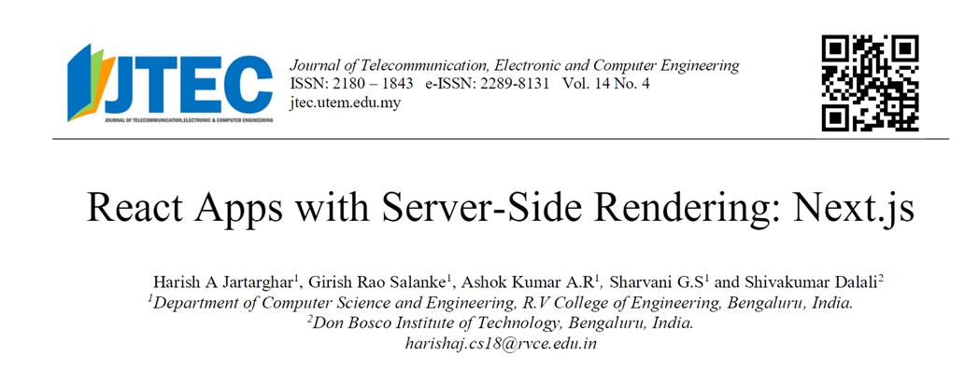
SATHYABAMA INSTITUTE OF SCIENCE AND TECHNOLOGY
DEPARTMENT OF COMPUTER SCIENCE AND ENGINEERING
BASE PAPERS

Slide 10
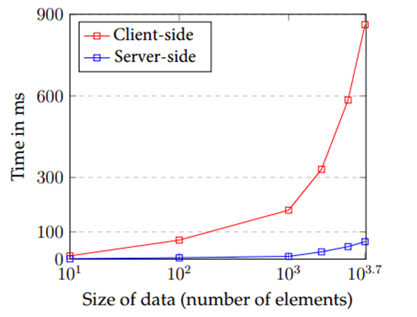
SATHYABAMA INSTITUTE OF SCIENCE AND TECHNOLOGY
DEPARTMENT OF COMPUTER SCIENCE AND ENGINEERING
PROCESSING TIMES
The graph shows the processing times for Next.js server-side rendering (SSR) and React.js client-side rendering (CSR) as the amount of data processed increases. As you can see, the SSR times are much lower than the CSR times, especially for larger amounts of data.
This is because SSR renders the page on the server before it is sent to the client, while CSR renders the page on the client after it is loaded. This means that SSR has access to all of the data that is needed to render the page, while CSR has to wait for the data to load from the server.

Slide 11
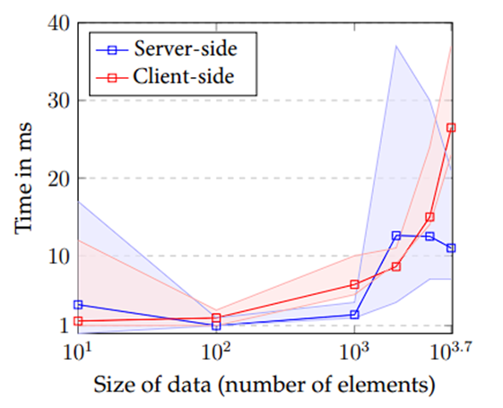
SATHYABAMA INSTITUTE OF SCIENCE AND TECHNOLOGY
DEPARTMENT OF COMPUTER SCIENCE AND ENGINEERING
TRANSFER
The graph shows that the number of elements is a major factor in determining the rendering time.
If you are trying to reduce the rendering time, you can try to reduce the number of elements that need to be rendered.
You can also try to use a more efficient rendering engine.

Slide 12
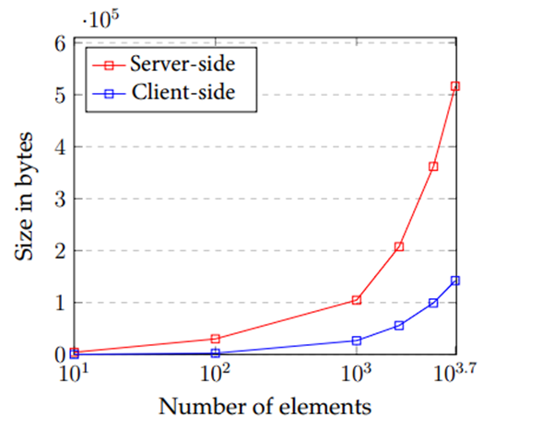
SATHYABAMA INSTITUTE OF SCIENCE AND TECHNOLOGY
DEPARTMENT OF COMPUTER SCIENCE AND ENGINEERING
TRANSFER SIZES
The graph shows that the size of the data transferred increases as the number of elements in the DOM increases.
This is because each element in the DOM requires a certain amount of data to be transferred, so the more elements there are, the more data needs to be transferred.

Slide 13
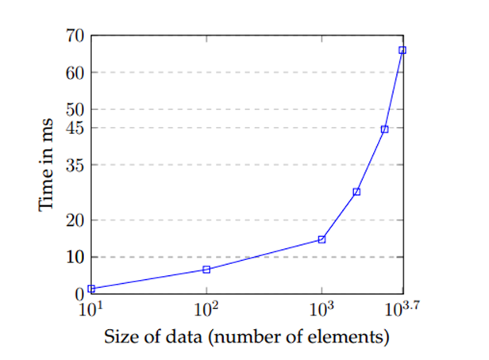
SATHYABAMA INSTITUTE OF SCIENCE AND TECHNOLOGY
DEPARTMENT OF COMPUTER SCIENCE AND ENGINEERING
SSR DOM MANIPULATION TIMES
The graph shows the time it takes to manipulate the DOM (Document Object Model) on the server side (SSR) as the size of the data (number of elements) increases.
The time increases linearly, meaning that it takes twice as long to manipulate the DOM for twice as much data.
This is because the server has to do more work to process the larger amount of data.

Slide 14
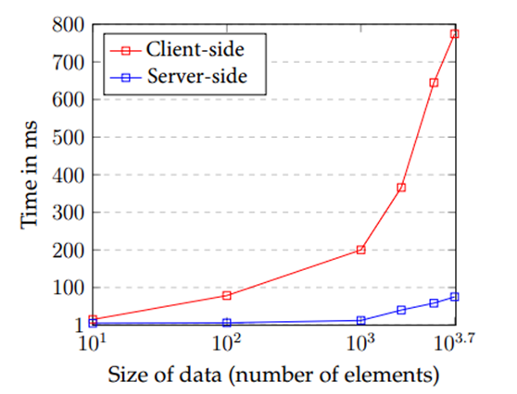
SATHYABAMA INSTITUTE OF SCIENCE AND TECHNOLOGY
DEPARTMENT OF COMPUTER SCIENCE AND ENGINEERING
TOTAL TIME (PROCESSING + TRANSFER + DOM MANIPULATION)
The graph shows the total time it takes to process, transfer, and manipulate DOM data on the client side and server side. The x-axis shows the size of the data in terms of the number of elements, and the y-axis shows the total time in milliseconds.
The graph shows that the total time increases as the size of the data increases. However, the rate of increase is much steeper on the client side than on the server side. This is because the client side has to do more processing and manipulation of the DOM data.

Slide 15
SATHYABAMA INSTITUTE OF SCIENCE AND TECHNOLOGY
DEPARTMENT OF COMPUTER SCIENCE AND ENGINEERING
FEATURES OF THE PROJECT
Server-Side Rendering for Improved Performance
Database Password Encryption using JSON Web Tokens (JWT)
Advanced Search Functionality
Rapid Application Submission
Rapid Certificate Distribution
User-Centric Dashboard and User Interface (UI)
Intelligent Authentication
Session Management for Login State
Hierarchical Administration Structure
Multi-state Loading and Dynamic Views
Admin Panel for College Administrators

Slide 16


SATHYABAMA INSTITUTE OF SCIENCE AND TECHNOLOGY
DEPARTMENT OF COMPUTER SCIENCE AND ENGINEERING
LINKS
PRODUCTION
DEMO

Slide 17
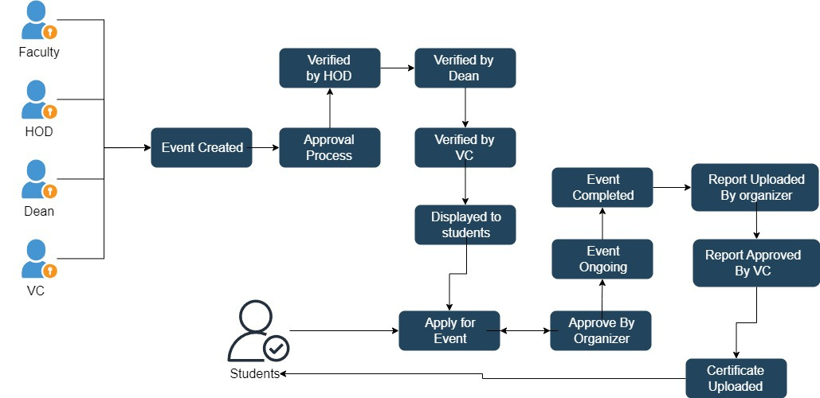
SATHYABAMA INSTITUTE OF SCIENCE AND TECHNOLOGY
DEPARTMENT OF COMPUTER SCIENCE AND ENGINEERING
FLOW CHART

Slide 18
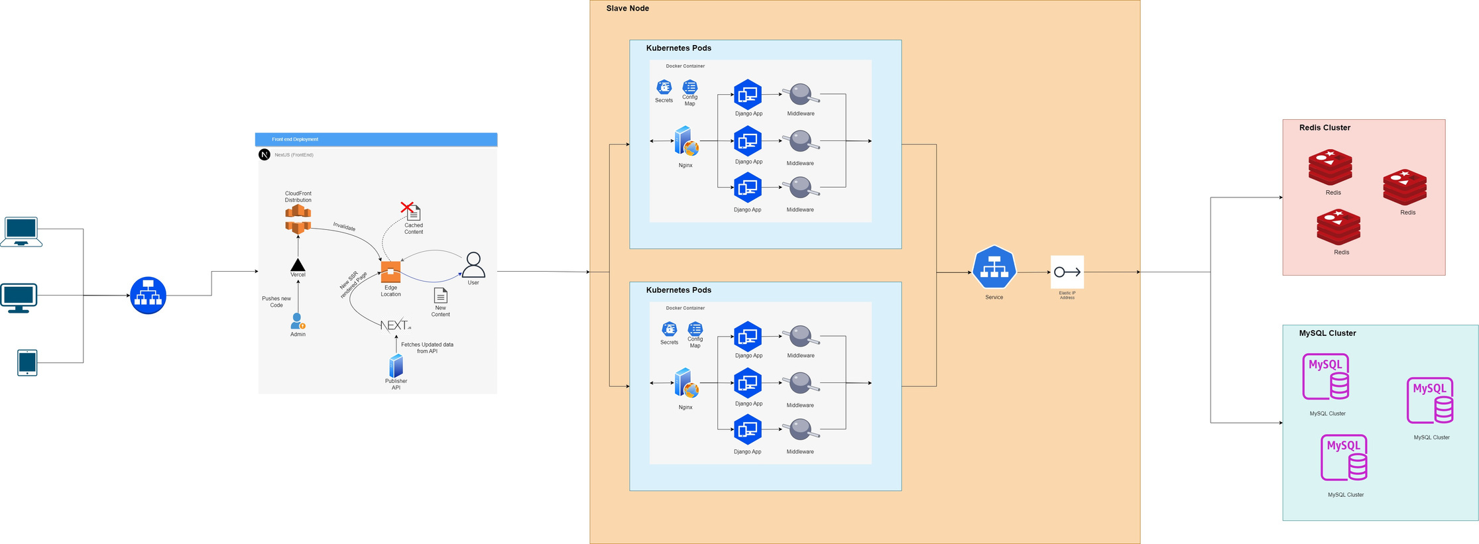
SATHYABAMA INSTITUTE OF SCIENCE AND TECHNOLOGY
DEPARTMENT OF COMPUTER SCIENCE AND ENGINEERING
SYSTEM ARCHITECTURE

Slide 19
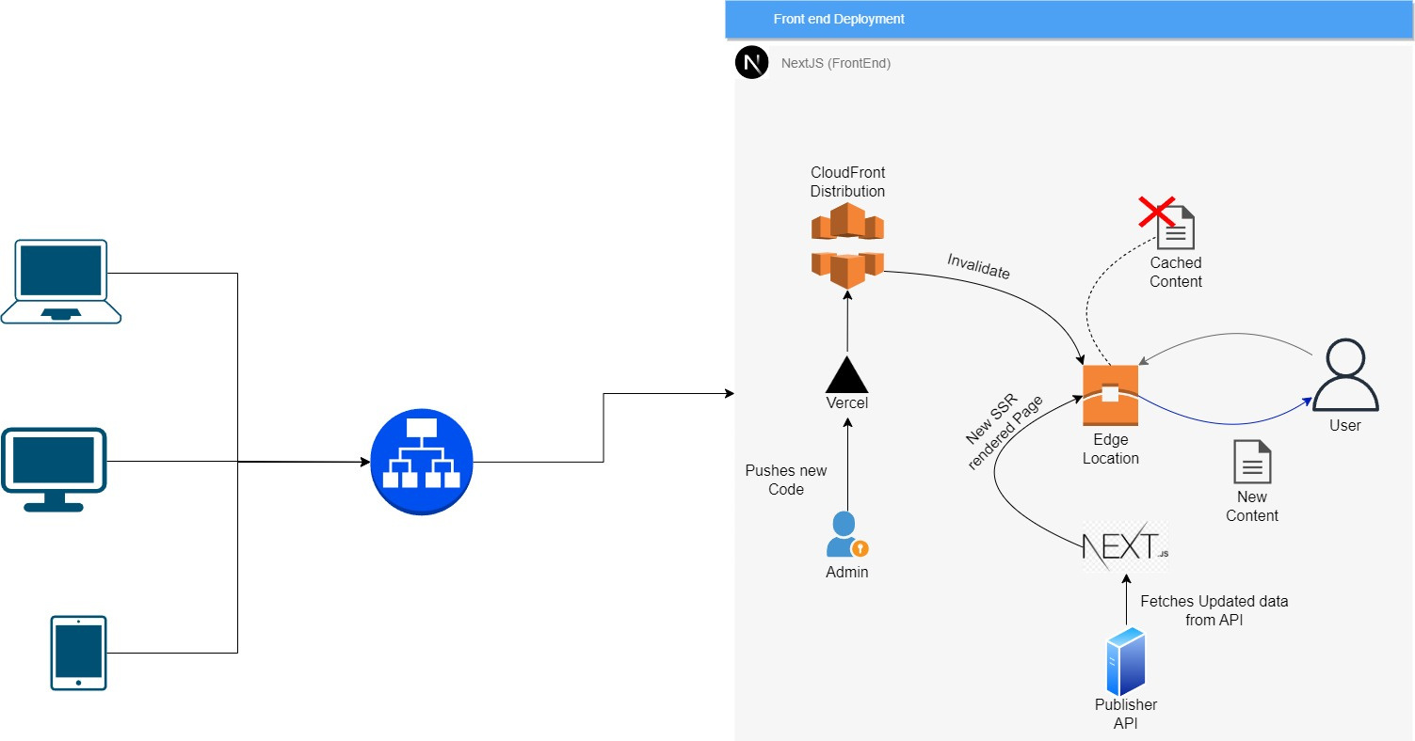
SATHYABAMA INSTITUTE OF SCIENCE AND TECHNOLOGY
DEPARTMENT OF COMPUTER SCIENCE AND ENGINEERING
SSR ARCHITECTURE

Slide 20
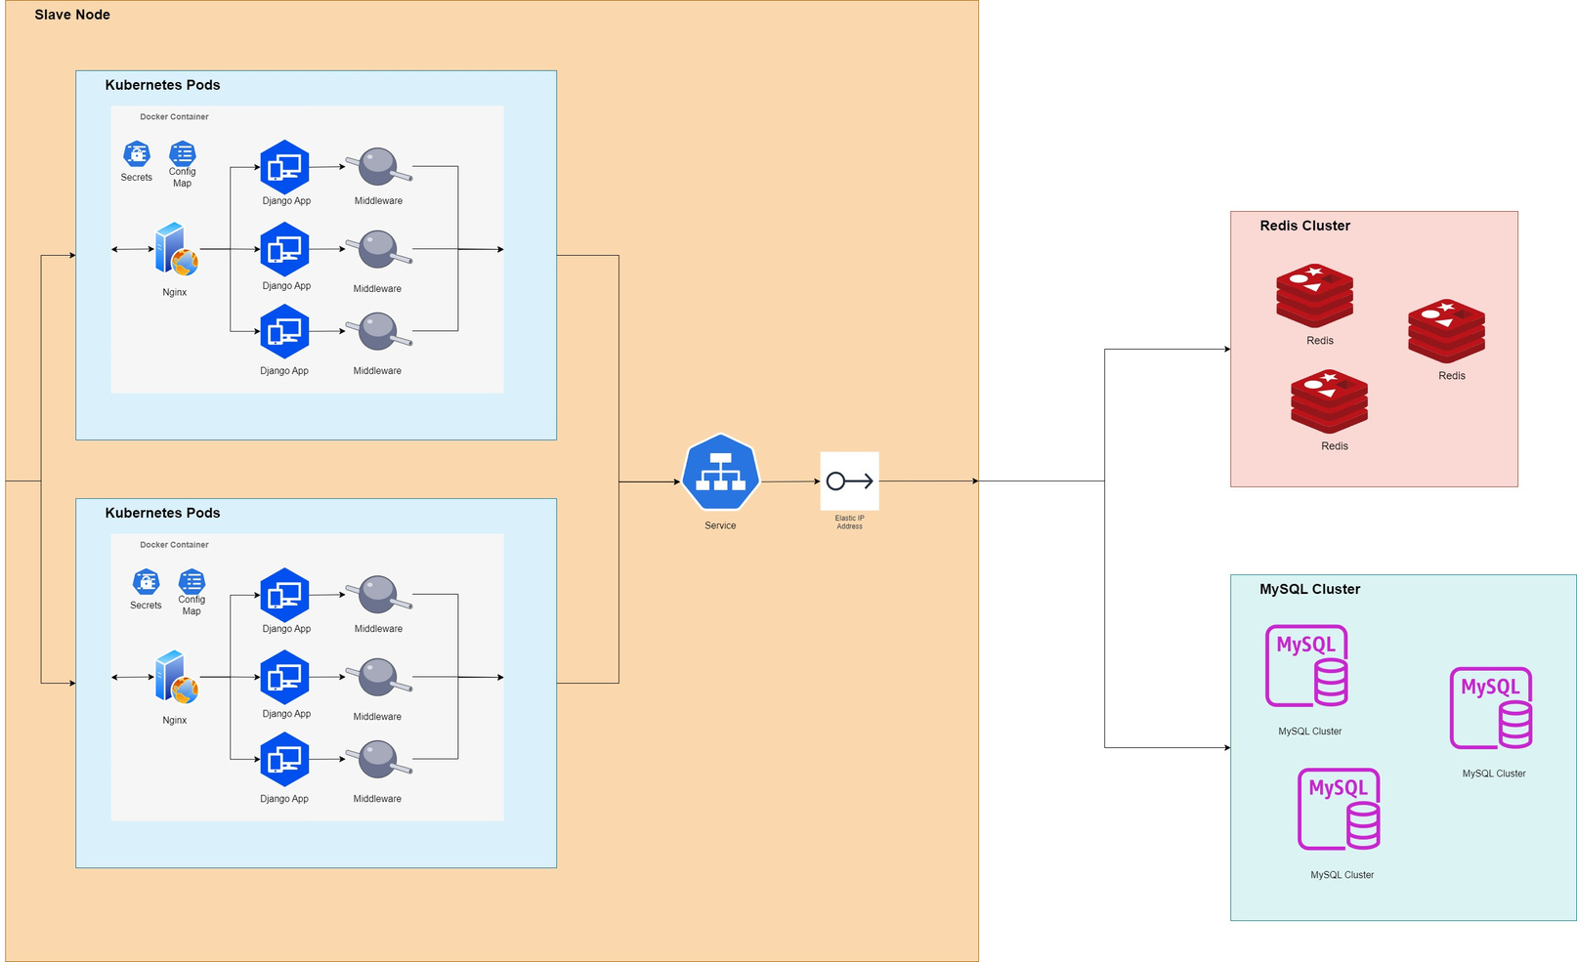
SATHYABAMA INSTITUTE OF SCIENCE AND TECHNOLOGY
DEPARTMENT OF COMPUTER SCIENCE AND ENGINEERING
BACKEND ARCHITECTURE

Slide 21
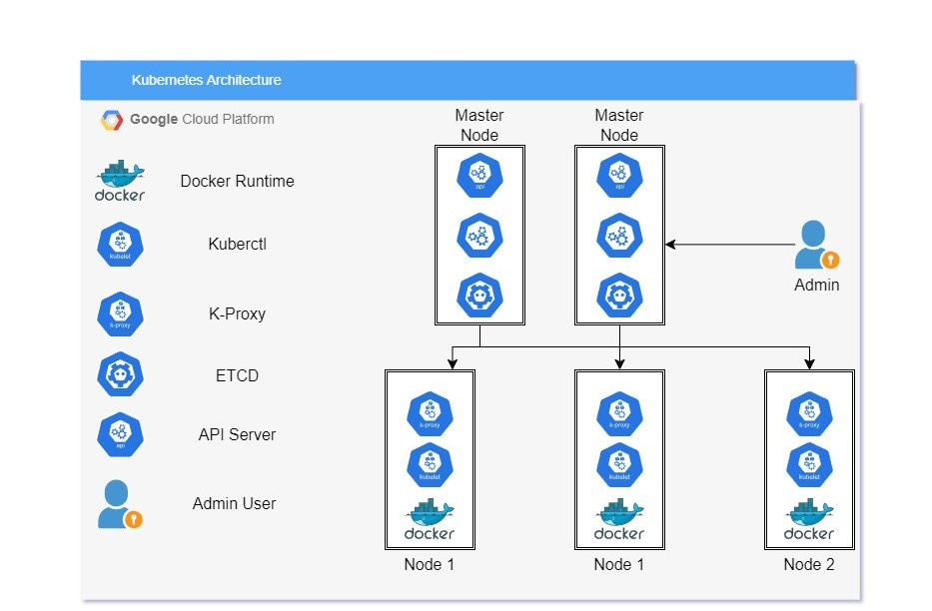
SATHYABAMA INSTITUTE OF SCIENCE AND TECHNOLOGY
DEPARTMENT OF COMPUTER SCIENCE AND ENGINEERING
KUBERNETES ARCHITECTURE

Slide 22
SATHYABAMA INSTITUTE OF SCIENCE AND TECHNOLOGY
DEPARTMENT OF COMPUTER SCIENCE AND ENGINEERING
MODULES
Authentication Service
E-mail Service
CDN (Content- Delivery Network)
CRON Jobs
Image Compression
Caching Service
Load Balancer Service
CI/CD with Jenkins
Data Pipeline Service with ERP
Bulk OTP Polling Queue

Slide 23
SATHYABAMA INSTITUTE OF SCIENCE AND TECHNOLOGY
DEPARTMENT OF COMPUTER SCIENCE AND ENGINEERING
BENCHMARKS
80%
70%
65%
More Efficient Event Approval and Tracking
Faster Event Announcements
Faster Initial Load Times

Slide 24
SATHYABAMA INSTITUTE OF SCIENCE AND TECHNOLOGY
DEPARTMENT OF COMPUTER SCIENCE AND ENGINEERING
REFERENCES
P. Kishore and M. B M, “Evolution of Client-Side Rendering over Server-Side Rendering,” vol. 3, no. 2, pp. 1–10, 2020.
Vercel, “Data Fetching Overview,” 2022. https://nextjs.org/docs/basicfeatures/data-fetching/index (accessed Jan. 24, 2022)
S. G. V and A. Sandeep, “Comprehensive Analysis of React-Redux Development Framework,” Int. J. Creat. Res. Thoughts www.ijcrt.org, vol. 8, no. 4, p. 4230, 2020.
B. McNamee, "Server-Side Rendering with React: A Comprehensive Guide," Smashing Magazine, Nov. 2020.
A. Bhattacharya, "The Pros and Cons of Server-Side Rendering in React Apps," The Startup, May 2022. https://medium.com/swlh/the-pros-and-cons-of-server-side-rendering-in-react-apps-3505f4a2fcd5.
A. Srinivasan, "React SSR vs CSR: Benefits and Trade-offs," LogRocket Blog, May 2021. Available: https://blog.logrocket.com/react-ssr-vs-csr-benefits-and-trade-offs/.
S. Jangra, "A Comprehensive Guide to Server-Side Rendering with Next.js," Hashnode Blog, Mar. 2023. https://hashnode.com/post/a-comprehensive-guide-to-server-side-rendering-with-nextjs-ckxwoagb100x3gvs15kxdhswf.

Slide 25
THANK YOU

